Slide 1
Applying a logistic regression model to a vehicle loan data set
Presenter :Michael Meyer

Slide 2
Context of project
The data set
Assumptions
Aim of the project

Slide 3
Basic Methodology
Prepare the inputs
Build the model
Test the flexibility of model

Slide 4
Data preprocessing
Categorize data
Variable transformation
Judgemental screening
Missing values
Splitting between training and validation data sets.

Slide 5
Exploratory data analysis
Outlier detection
Investigating distribution of inputs
Testing signifance levels and correlations
Scaling continous variables
SWOE coding for categorical variables.

Slide 6
Variable screening
Reducing redundant variables:
Variable clustring
Detecting non-linear assocociations

Slide 7
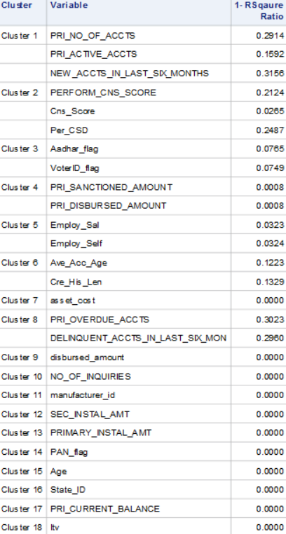
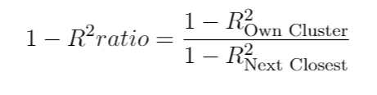
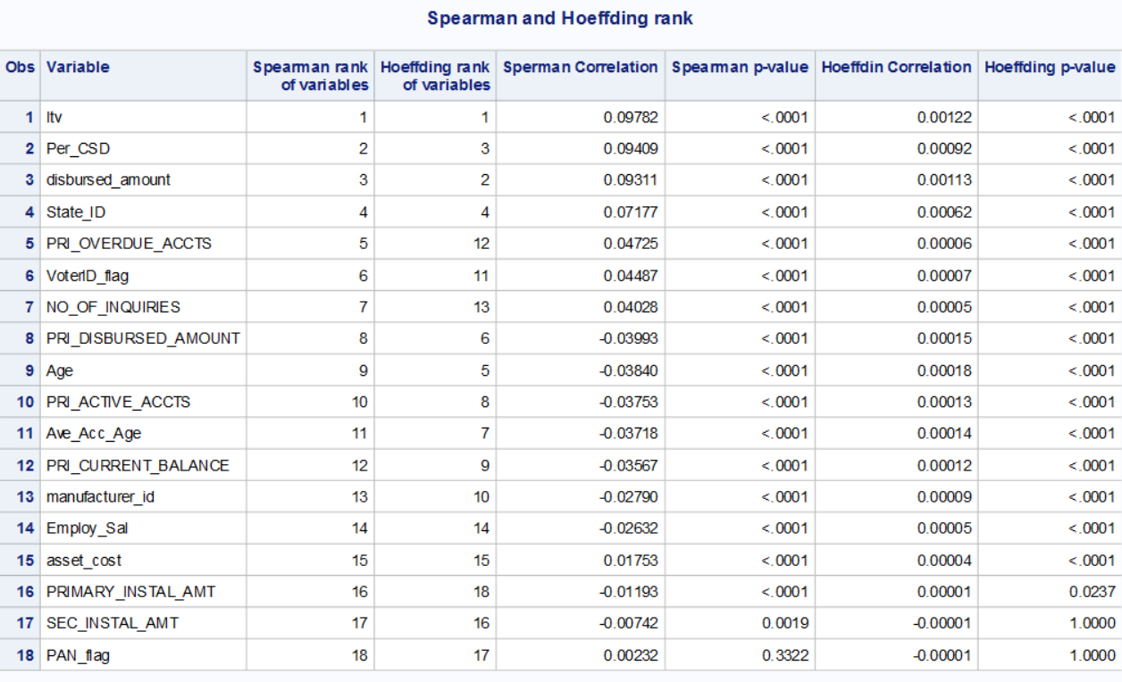
Variable screening results

Slide 8
Fitting the model
Model selection
Select applicable type of model
Types of variable selection
Detecting Interactions
Model fit statistics
Final model

Slide 9
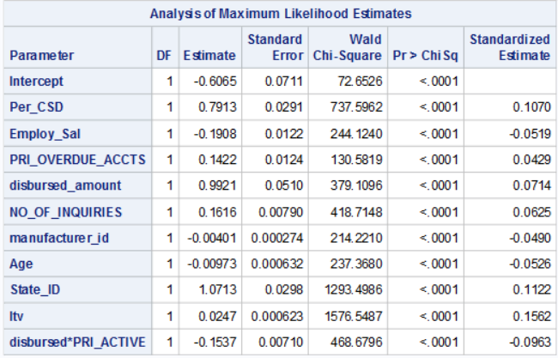
Final model
The c-statistic for the model on the training data is 0.635

Slide 10
Model validation
Performance measures
C-statistic
ROC curve
Lift Curve
Empirical CDF and K-S Statistic
Confusion Matrix

Slide 11
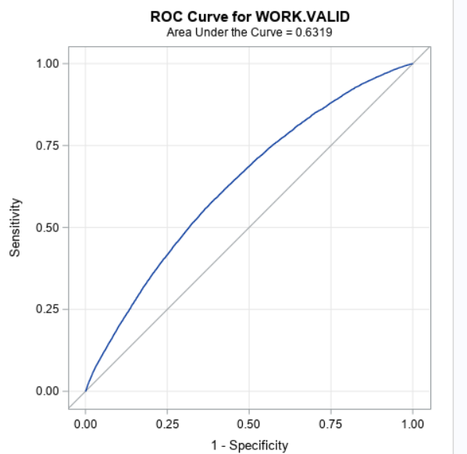
The ROC curve

Slide 12
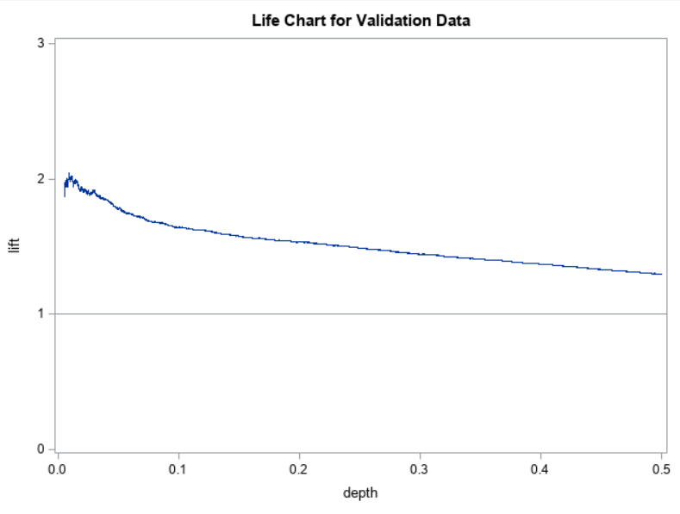
The lift curve

Slide 13
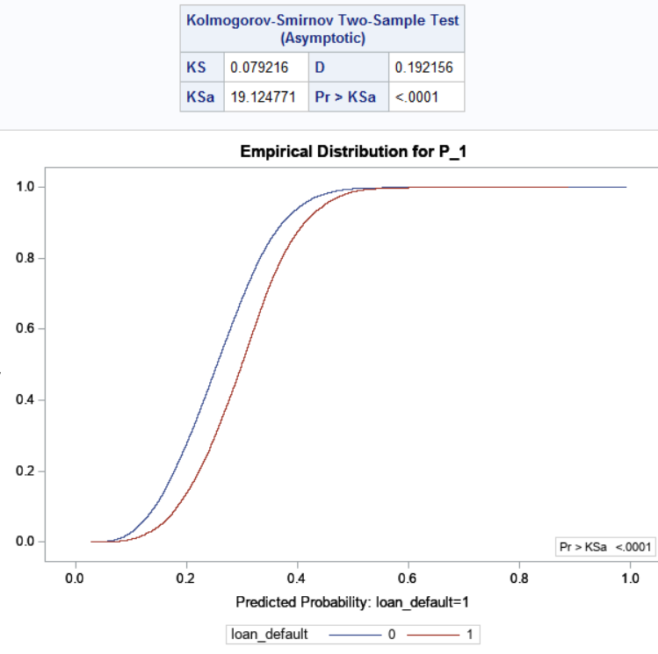
Empirical CDF of non-defaults and defaults

Slide 14
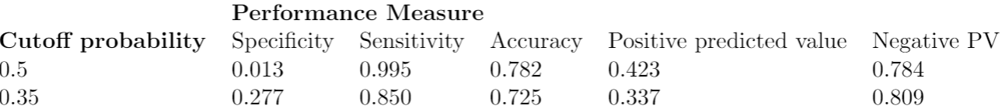
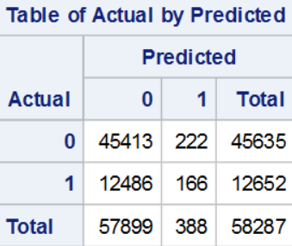
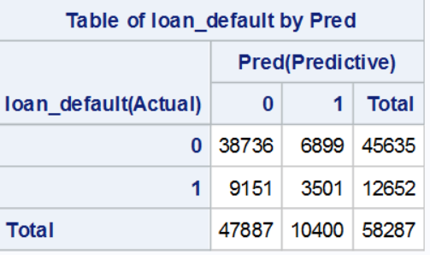
Confusion Matrix

Slide 15
Conclusion

